Slide 1

Ben-Elsom.com
By Ben Elsom

Slide 2
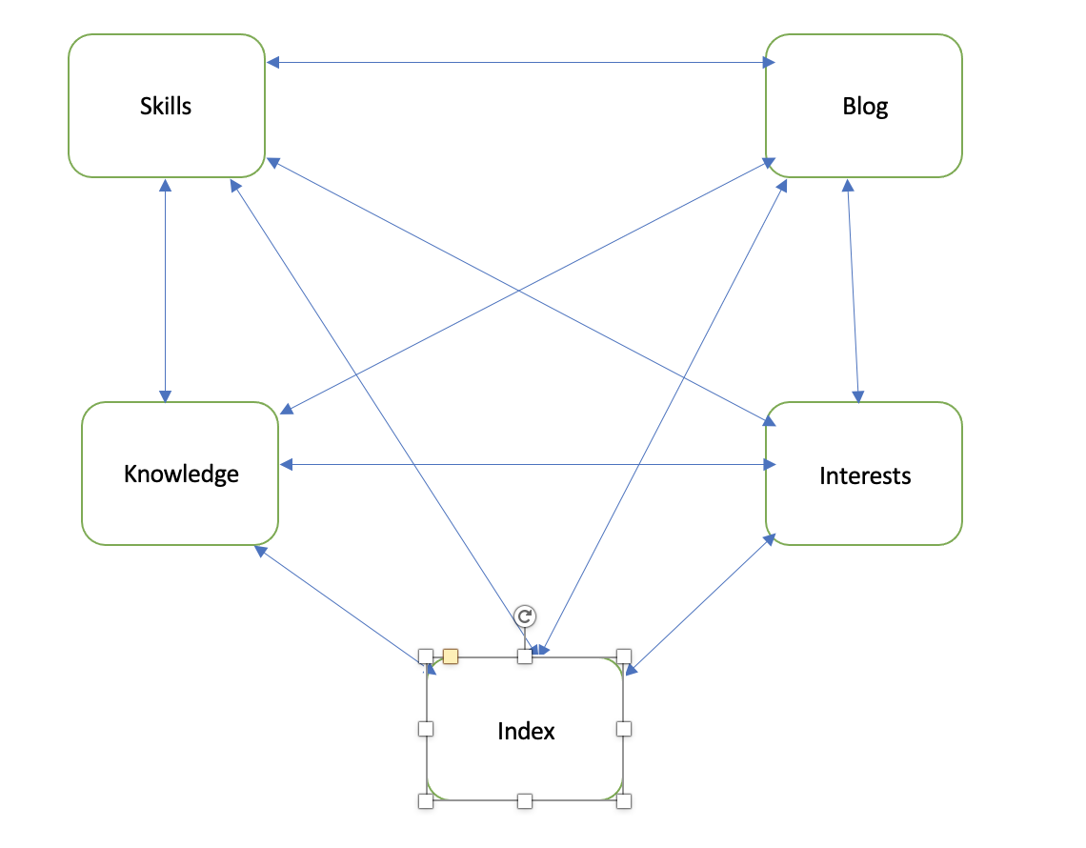
Sitemap

Slide 3
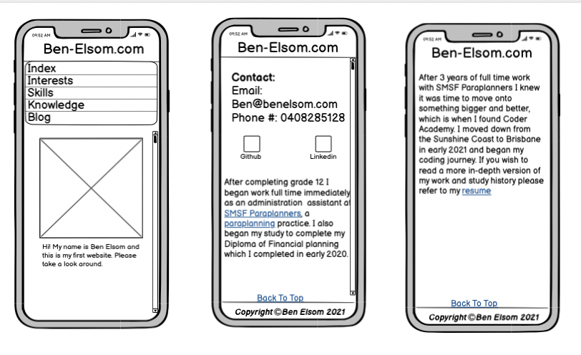
Wirefame – Index (Mobile)

Slide 4
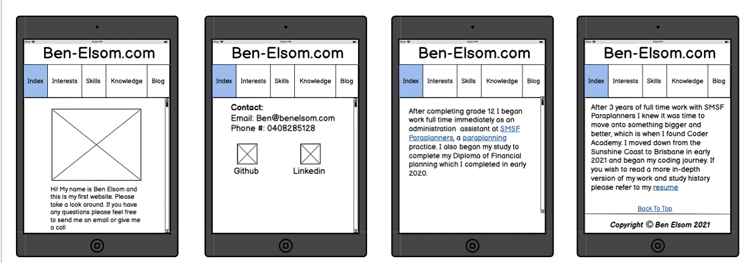
Wirefame – Index (Tablet)

Slide 5
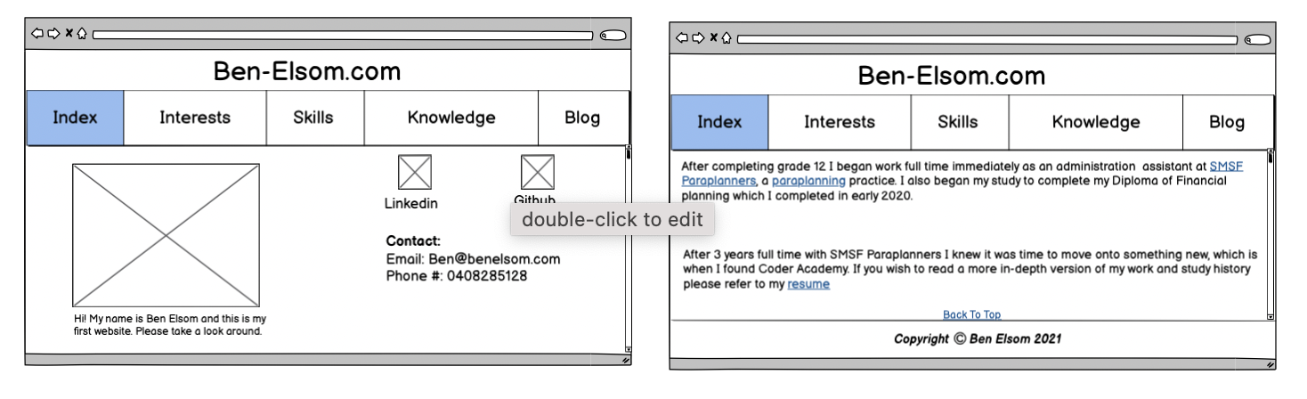
Wirefame – Index (Desktop)

Slide 6
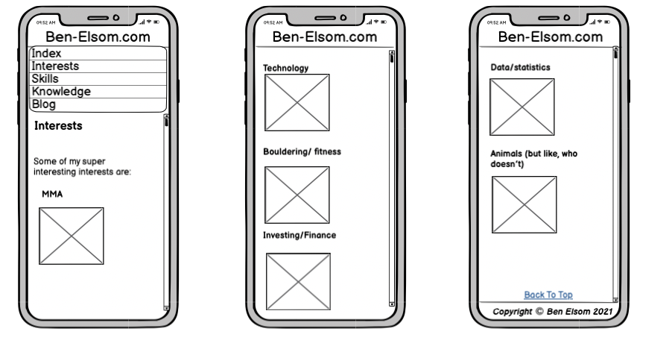
Wireframe – Interest (Mobile)

Slide 7
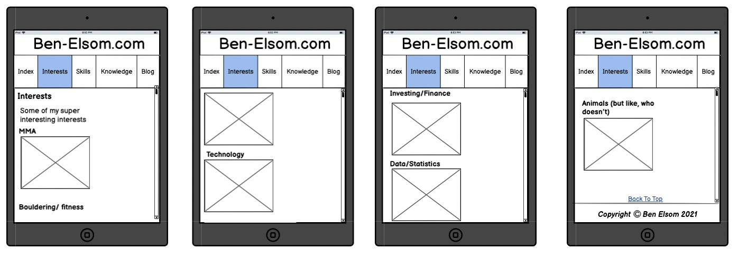
Wireframe – Interest (Tablet)

Slide 8
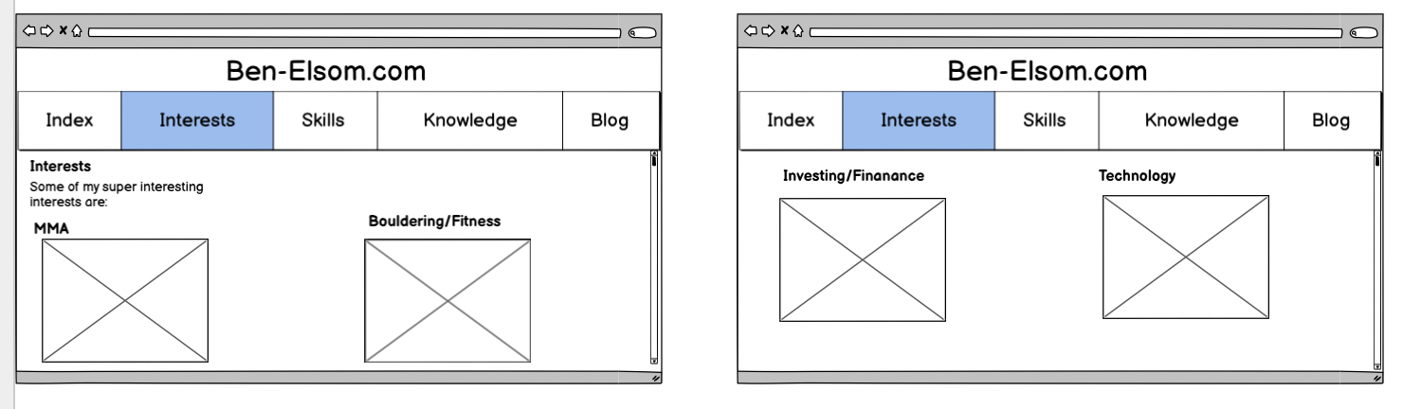
Wireframe – Interest (Desktop) P1

Slide 9
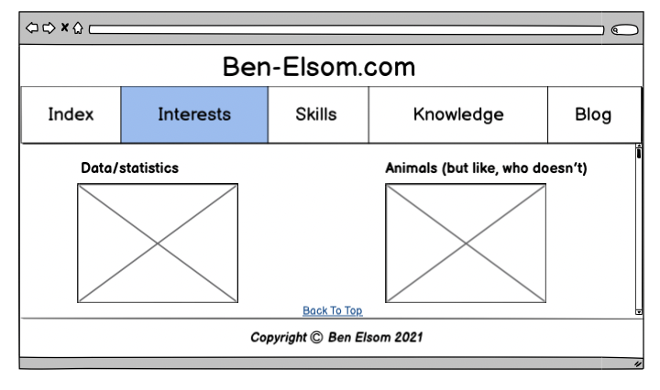
Wireframe – Interest (Desktop) P2

Slide 10
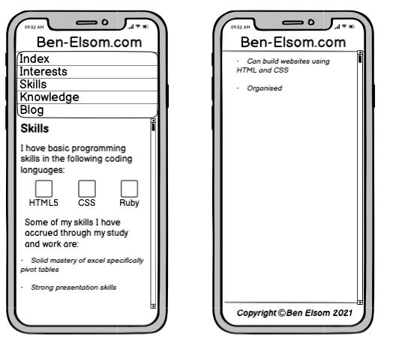
Wireframe – Skills (Mobile)

Slide 11
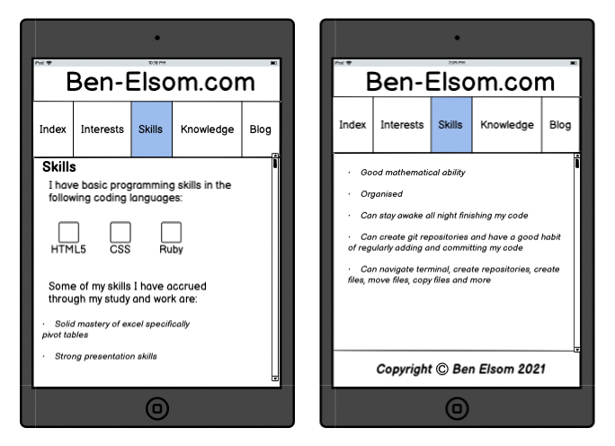
Wireframe – Skills (tablet)

Slide 12
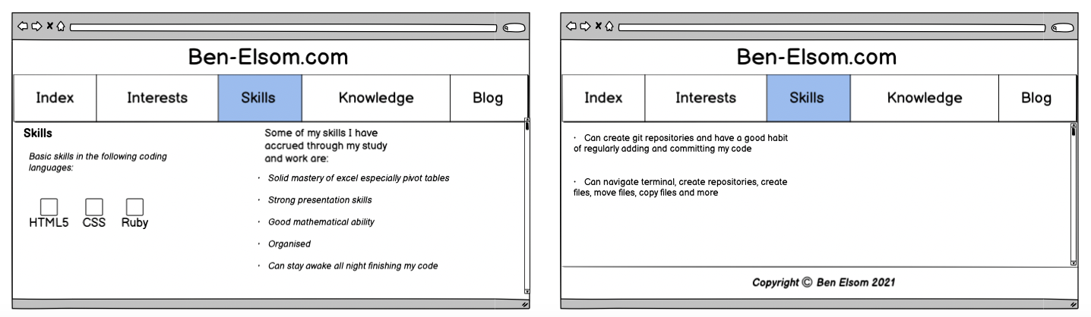
Wireframe – Skills (Desktop)

Slide 13
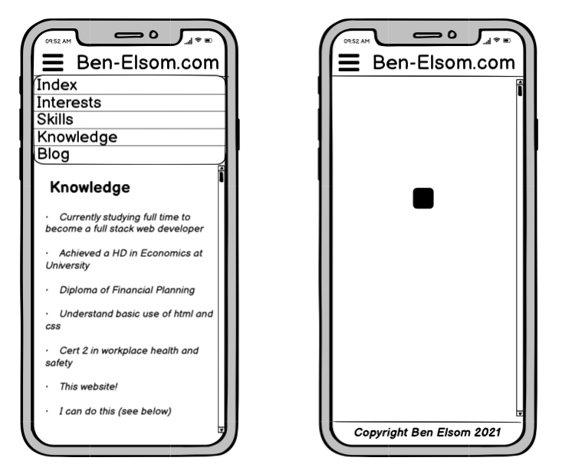
Wireframe – Interest (Mobile)

Slide 14
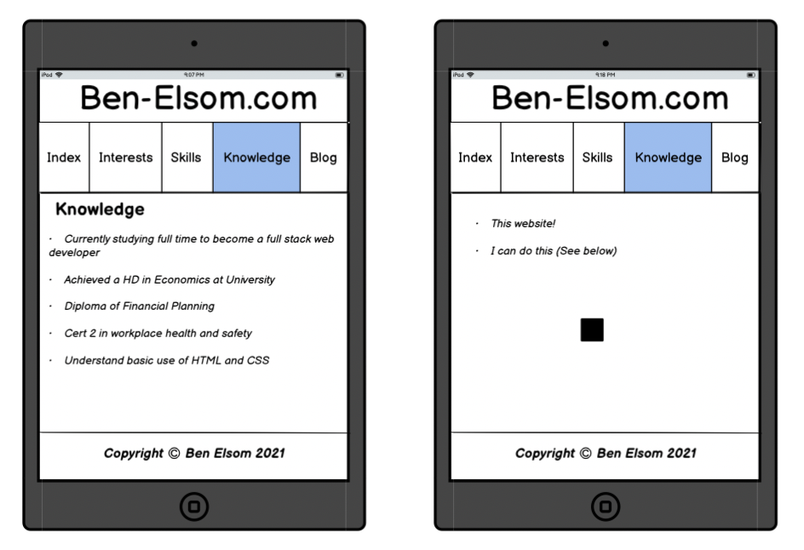
Wireframe – Interests (tablet)

Slide 15
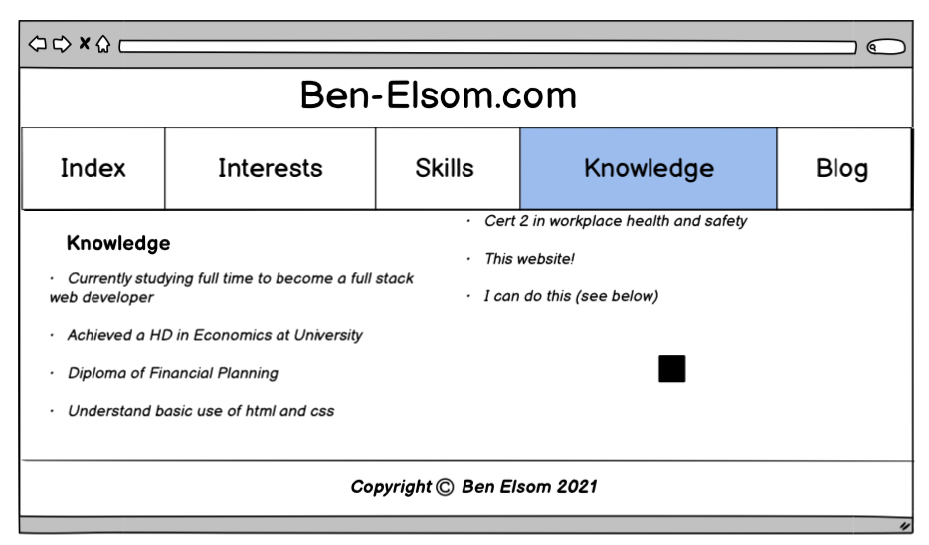
Wireframe – Interests (Desktop)

Slide 16
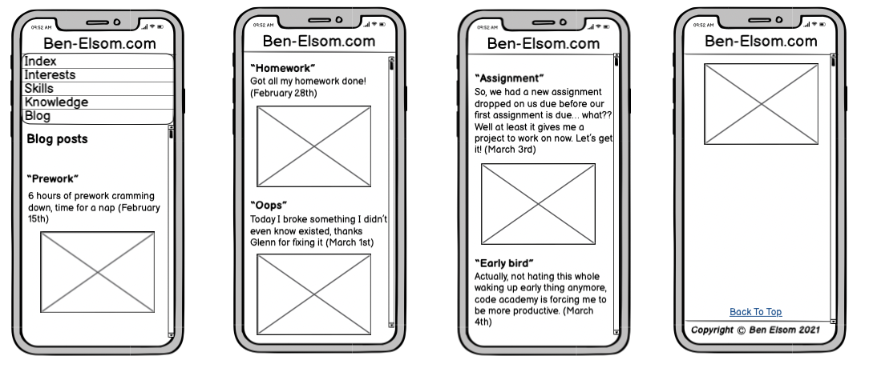
Wireframe – Blog (Mobile)

Slide 17
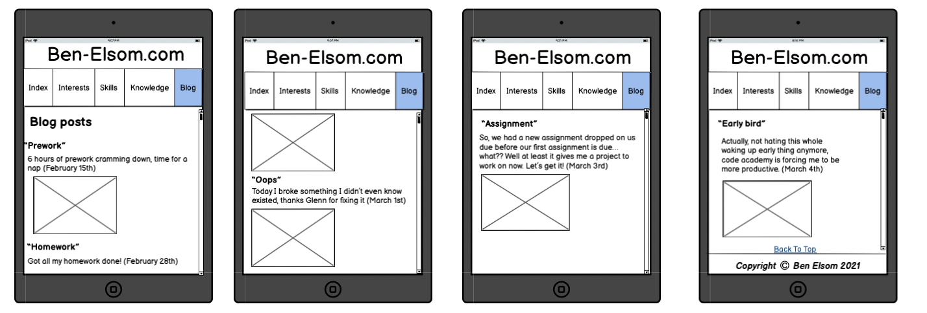
Wireframe – Blog (tablet)

Slide 18
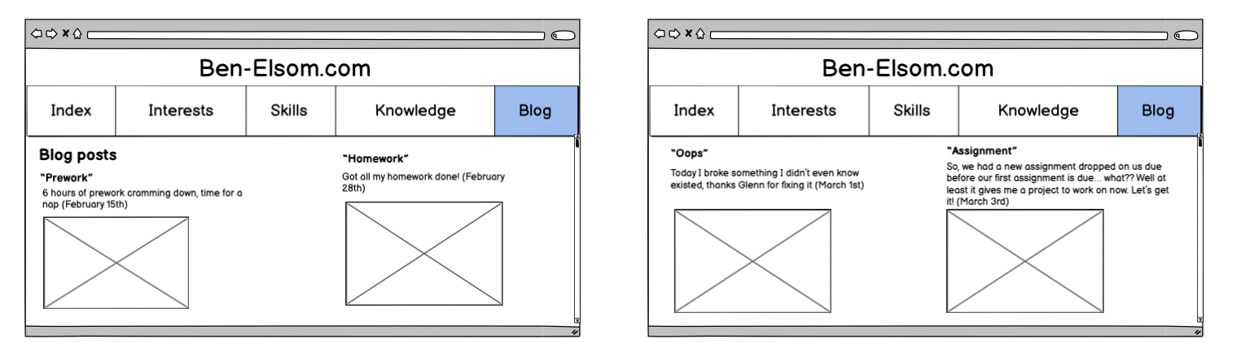
Wireframe – Blog (desktop) P1

Slide 19
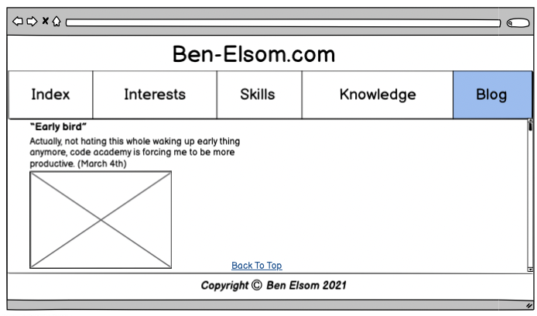
Wireframe – Blog (desktop) P2

Slide 20

Components

Slide 21
The components I used are
Animation (key frames)
Text
Images
Grid
Flex box
Media queries
Links to other html pages
Links to external webpages
Links to PDF
Links using photos
Scroll bar
Favicon

Slide 22

Color palette
Current page and hovered navigation bar
Body
Base navigation bar
Header and footer
For the text in the header and footer

Slide 23
Struggles
Time Management (spent time on things I shouldn’t)
Hamburger menu was more work than it was worth/ what I want to do vs what I can
What color palette to use as do not believe I am very good at design
Wasn’t sure whether I should add links to my Facebook and Instagram (ethical)
Free images

Slide 24

Favorite part
Animation
It will be published to BenElsom.com
So much learning! Becoming more confident in my skills as I apply them
Favicon is my favourite

Slide 25

Question time

